Slide 1
Variables
Part II

Slide 2
Accessing Containers
Data is held in containers called objects
Two ways to identify which object to access
Memory locations
Variables
Notes:
Data is held in containers called objects
Two ways to identify which object to access
Memory locations - not ideal because memory locations are large complicated numbers that may be different from computer to computer
Variables - easier to create and dont need to know the memory location

Slide 3
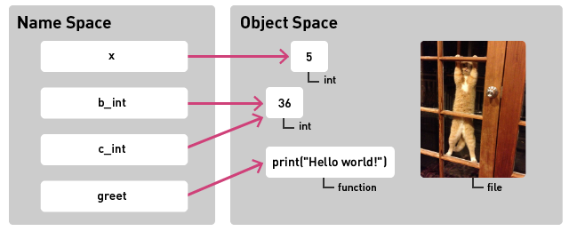
Variables
Variables go into a special object called a namespace.
When we create a variable (e.g., x = 5), the name x is bound to the object 5.
An object needs at least one name to be accessed.
Notes:
Variables go into a special object called a namespace.
When we create a variable (e.g., x = 5), the name x is bound to the object 5.
An object needs at least one name to be accessed.
If we lose all names that point to an object, it’s lost forever (the interpreter will ‘garbage-collect’ that variable so the memory can be reused

Slide 4
Static vs. Dynamic Type Checking
Python uses dynamic type checking.
Python does not use declarations, nor does it check a variable later to see if a string is then made an integer.
Errors are found during the execution.
In a static-type checking language, variables have to be declared and only used for that type.
The language will not let you declare a string and then later make that an integer.
Errors are found during compiling.

Slide 5
Dynamic Typing in Python
In Python, variables don’t have types
More freedom to change what variables point to
More opportunities for mistakes
Notes:
In Python, variables don’t have types
More freedom to change what variables point to
More opportunities for mistakes
Some programmers include the type of an object that variable name references (like b_int or c_int in the picture)

Slide 6
Variables

